Slide 1
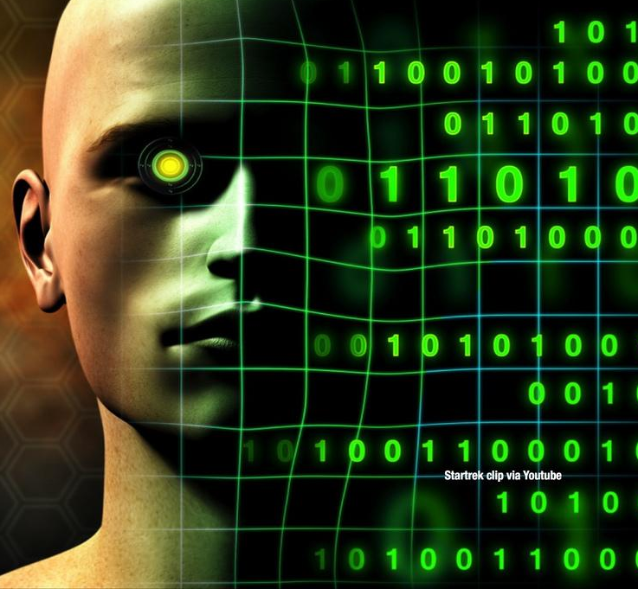
Smart Learner & Digitization
Dr. Md. Sabur Khan, Chairman, BoT,
Daffodil International University

Slide 2
Are YOU
READY
for the FUTURE?

Slide 3
PRESENT
SCENARIO

Slide 4
BANGLADESH
JOB MARKET STATUS

Slide 5
Recently Took interview of about 100+ candidates at Jobsbd in Marketing & Salesman Positions where about -
60% students applied from CSE
20% ETE & EEE and
20% from others

Slide 6
Asked CSE people!!!
Why you guys applied in Marketing & Sales

Slide 7
Boost up
your Sales by using MODERN MARKETING TOOLS

Slide 9
Job Markets & Employability
are being changed

Slide 10
Software
Farms
are not doing good

Slide 11
Lack of Practical
and Experimental Knowledge

Slide 12
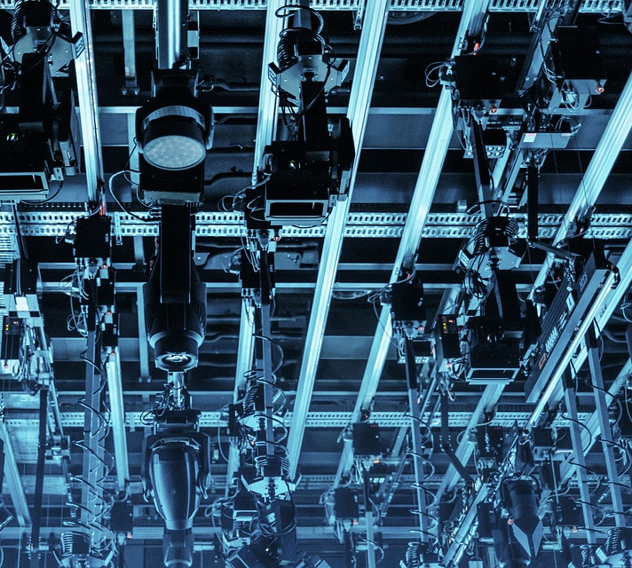
Trend of
Career Choice
by the
New Generations

Slide 13
200+
CSE students Claimed-
facing lot of troubles in basic knowledge
4th months’ semester is not enough.

Slide 14
A Big Number Of Students Couldn’t Set Their Career In Right Track
Social Concept &
Background
A major number of students of CSE are not getting confidence against the Jobs of CSE relevance
Huge Competition in Polytechnic/NU/NU-Private /Private-Public Universities
The image of CSE

Slide 15
What’s the Reality?

Slide 16
Students are not utilizing their
students life with heart & soul
according to their career track and
passion.
In CSE the average status of alumni are not still so successful

Slide 17
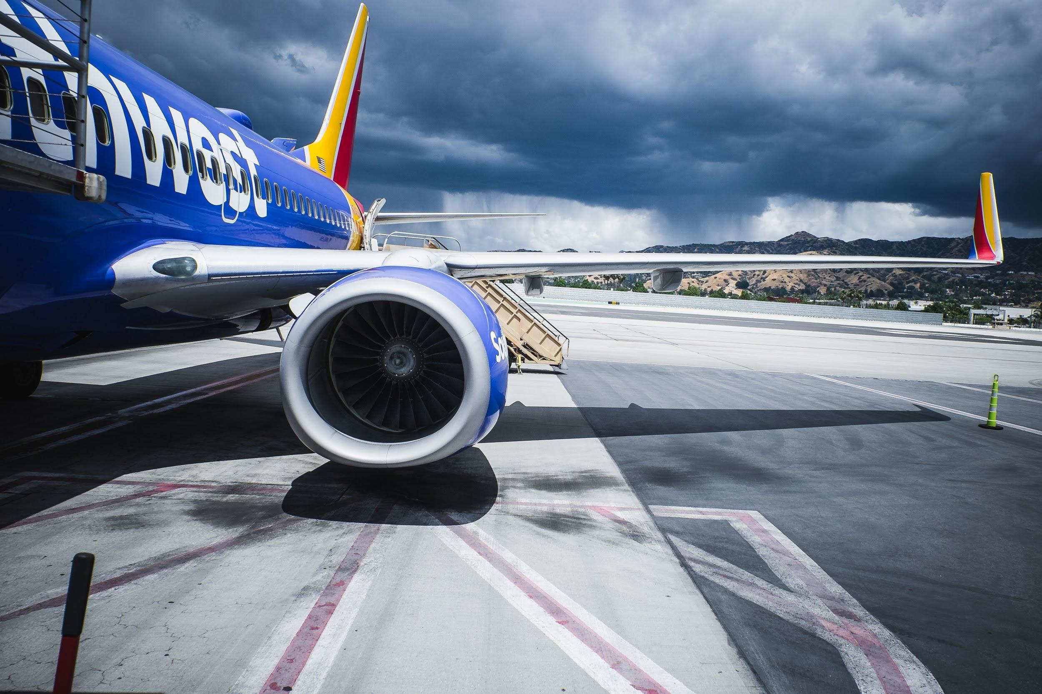
International
Market

Slide 19
Theory
Practical
Students & Teachers

Slide 20
Research based Project
In Association with Relevant Industry

Slide 21
“Real Life Software Development Program”
INTERNSHIP

Slide 22
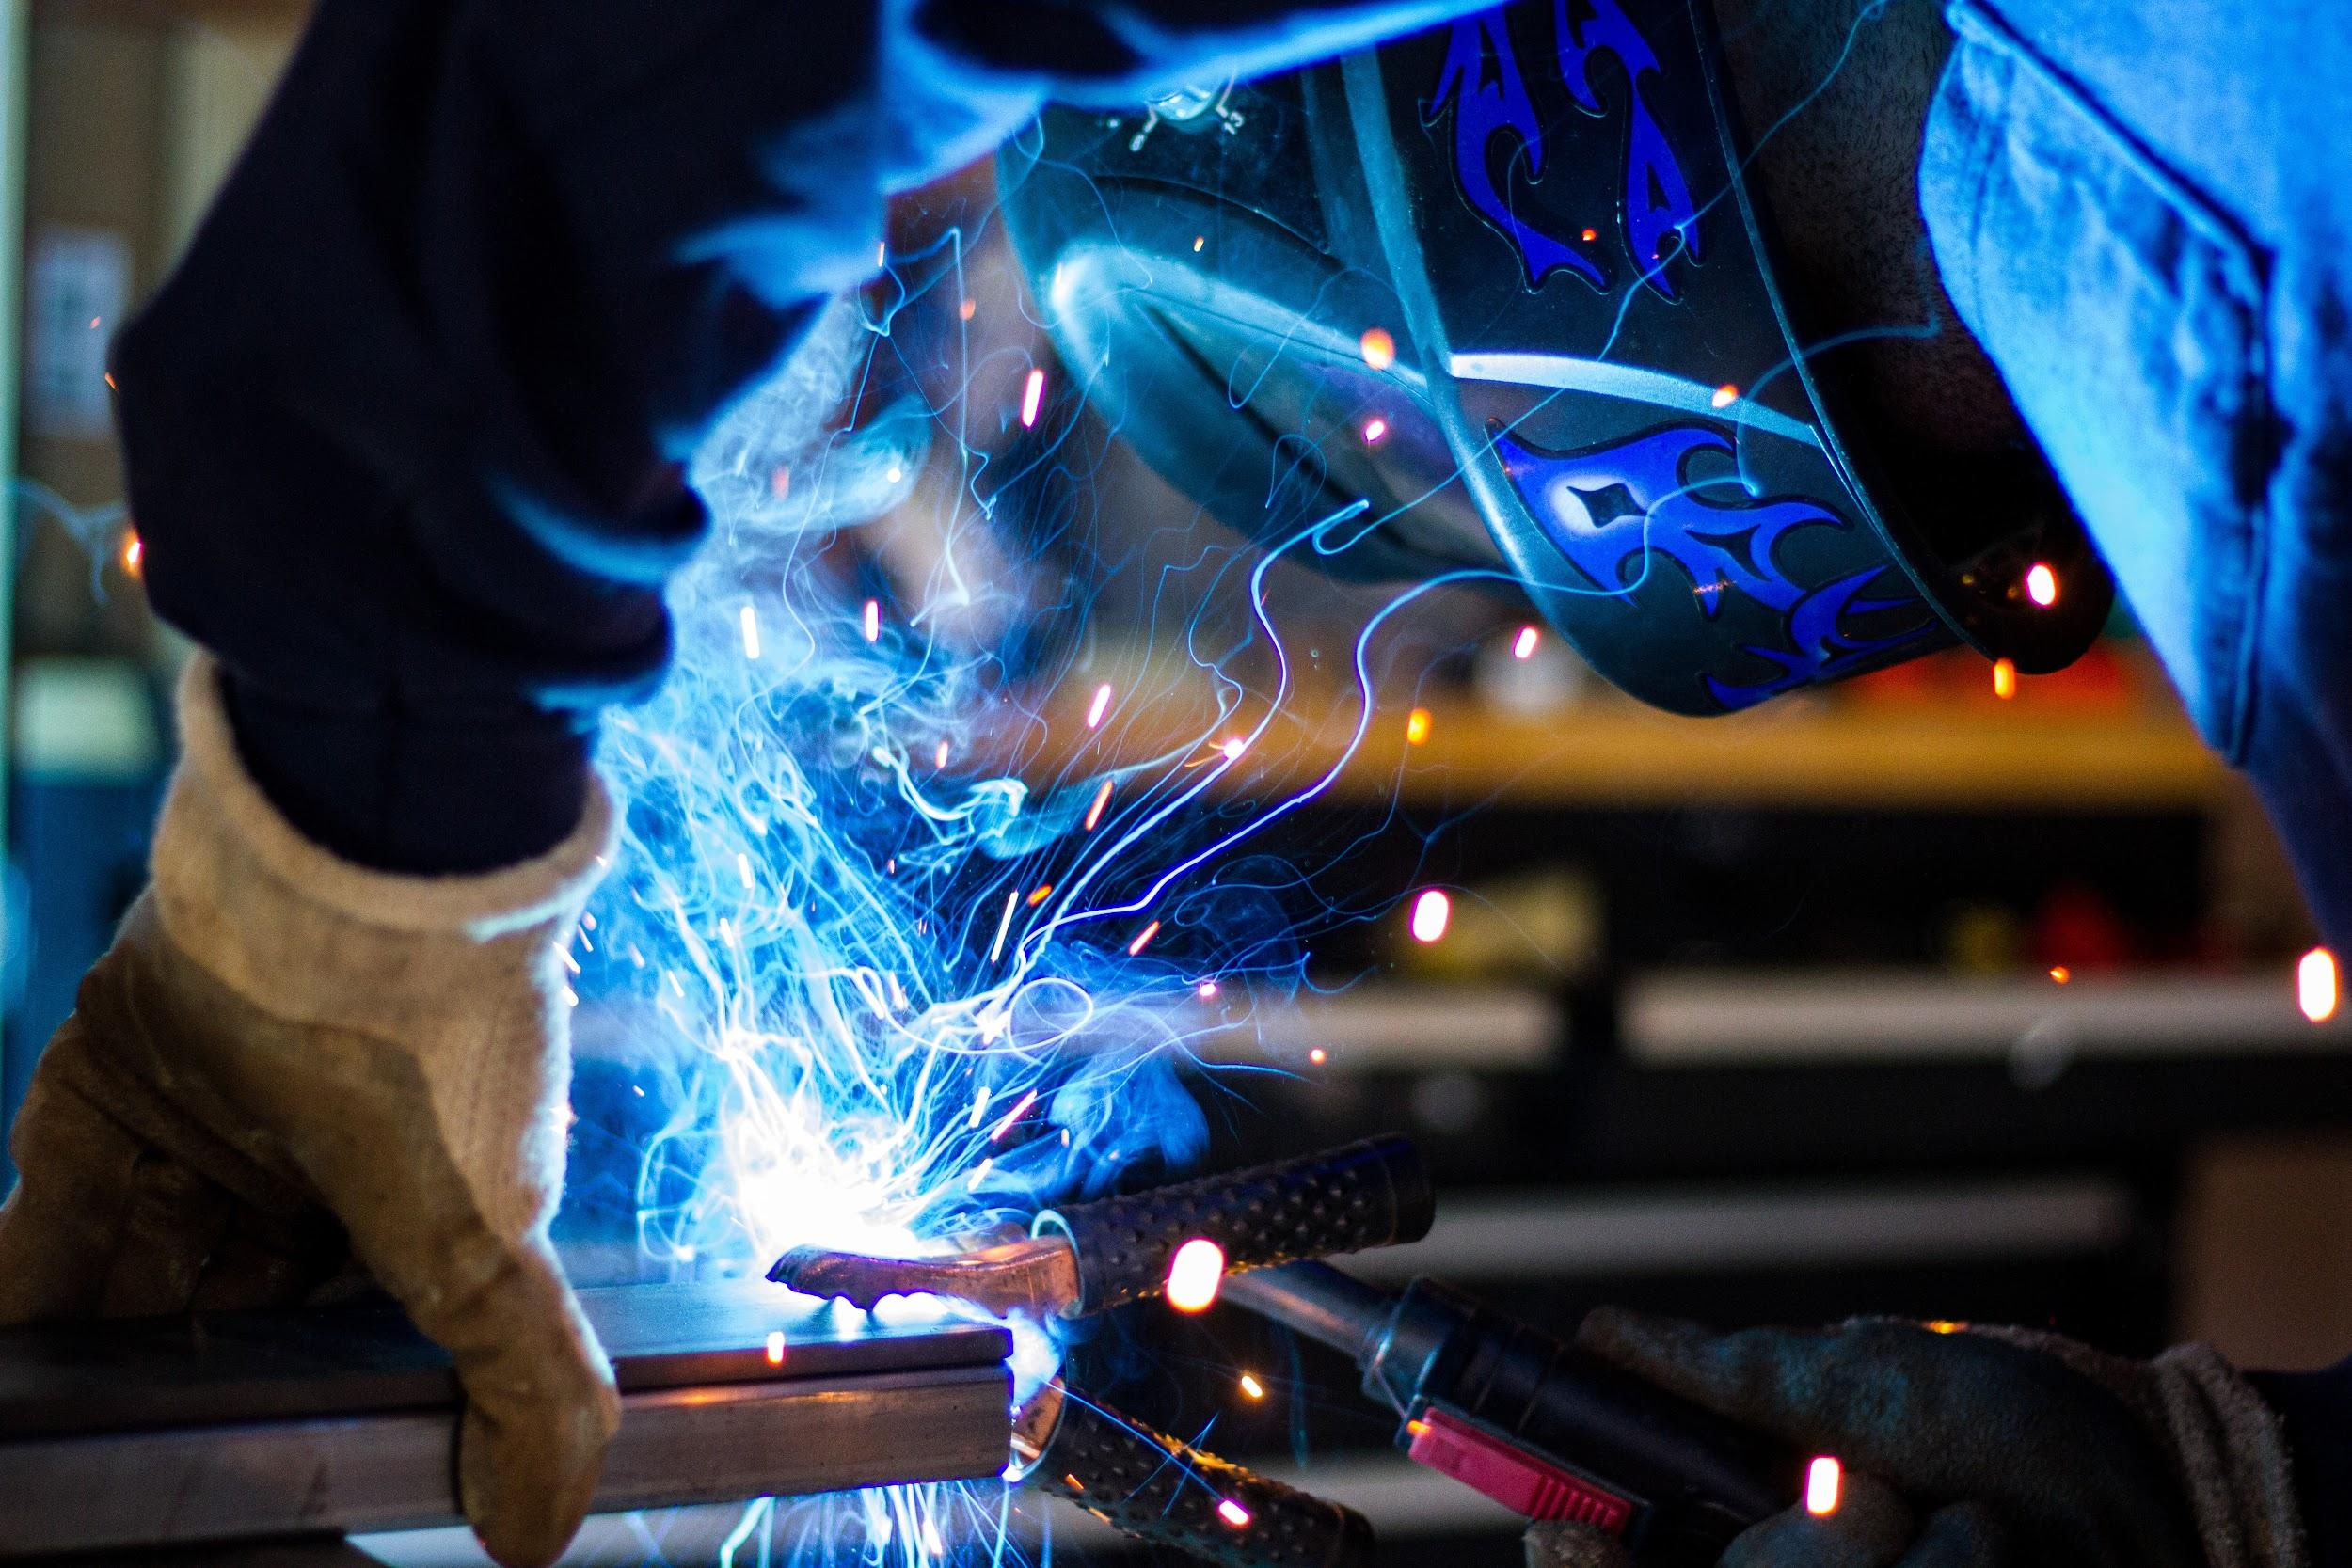
Research Center

Slide 23
Teaching
Materials
and
Industry base Teachers
Global Demands

Slide 25
“A TEACHER always
EXPECTS his
STUDENTS to
BECOME BETTER”

Slide 27
Best Apps
for
Teachers And Students

Slide 28
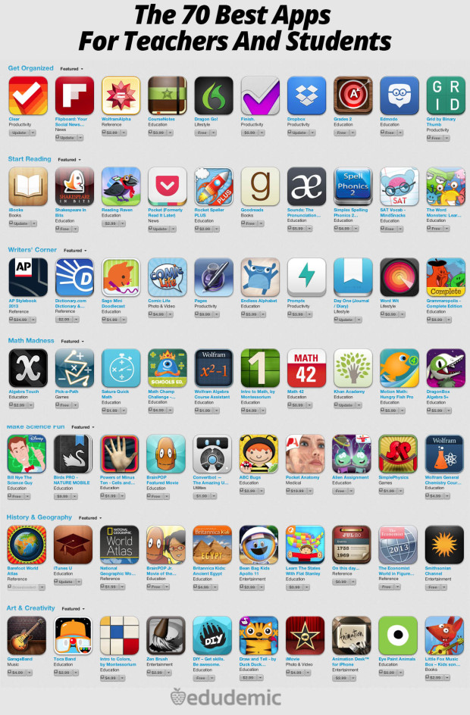
http://www.edudemic.com/70-best-apps-teachers-students/

Slide 29
ONLINE
LEARNING
SITES

Slide 30
Requirement
Analysis

Slide 31
CREATIVE
UI/UX Design

Slide 32
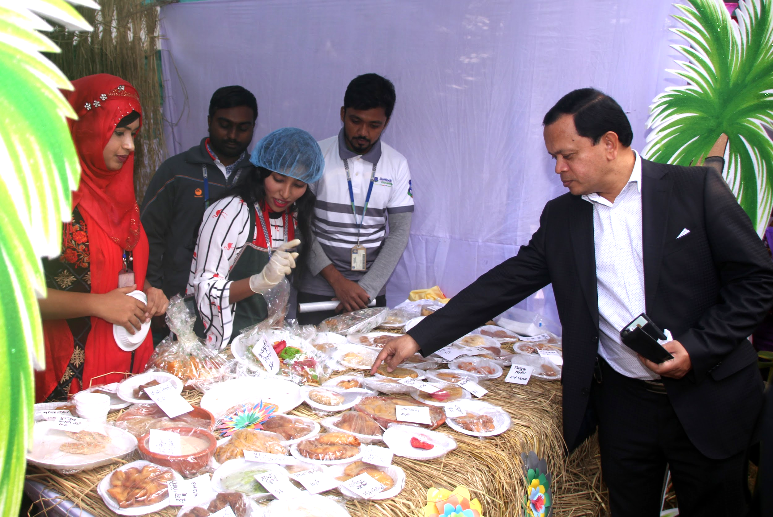
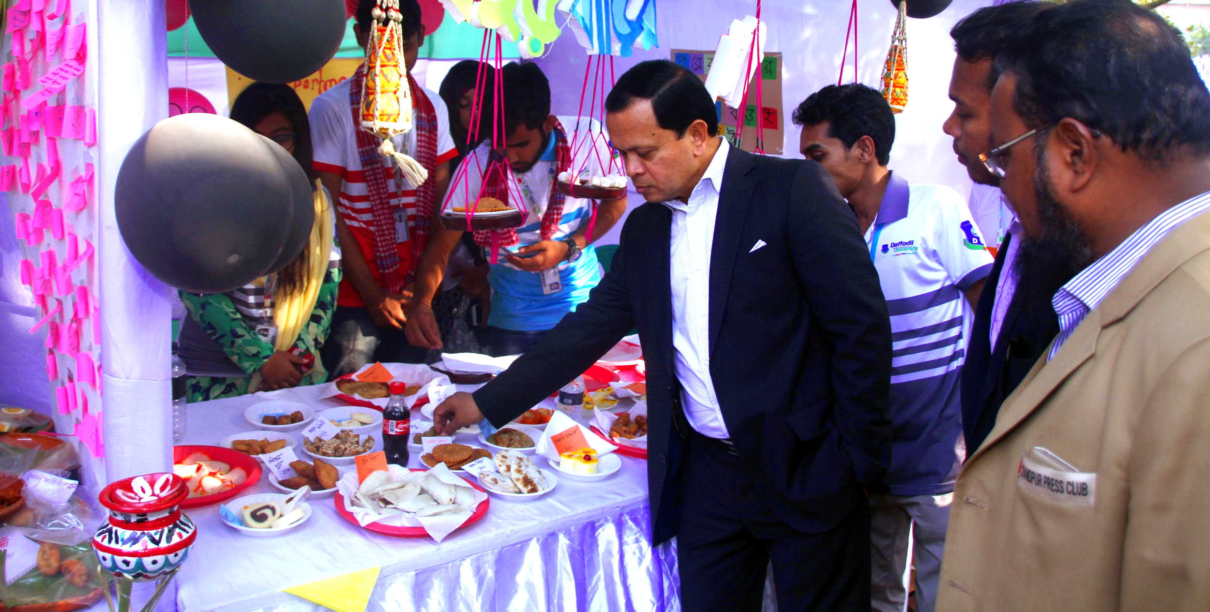
Entrepreneurial Attitude

Slide 33
TRENDING

Slide 34
Future Technology |
Digital World 2020

Slide 35
SMART
CITY

Slide 36
INTERNET
of
THINGS

Slide 37
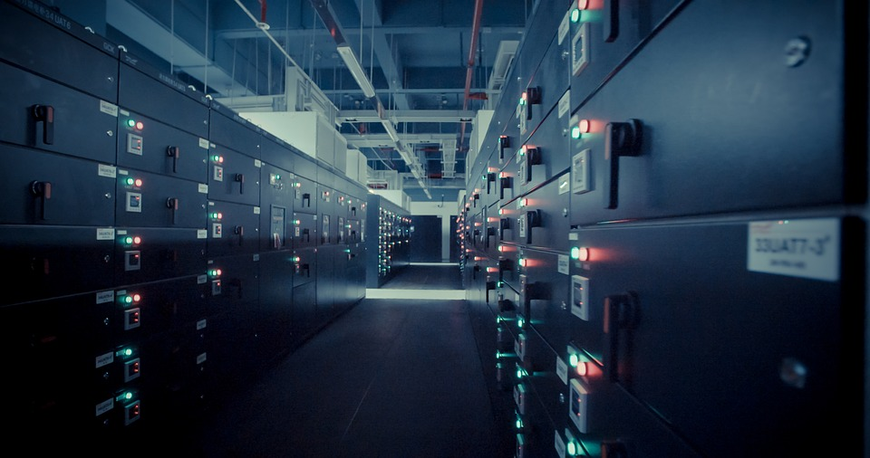
BIG
DATA

Slide 38
CLOUD COMPUTING

Slide 39
Artificial
Intelligence

Slide 40
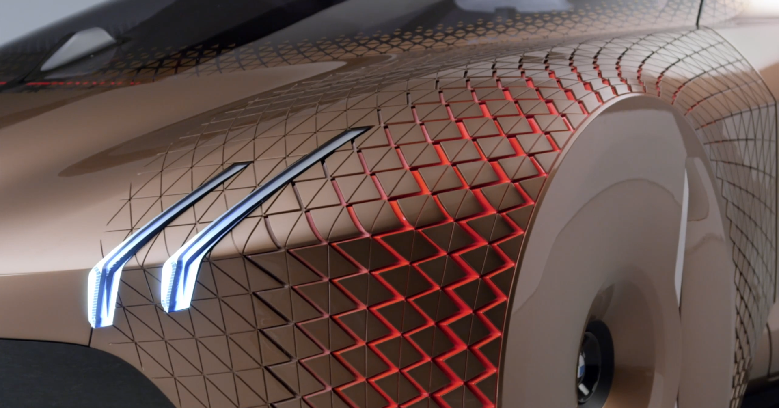
Self Driving Car

Slide 41
Bitcoin and Blockchain

Slide 42
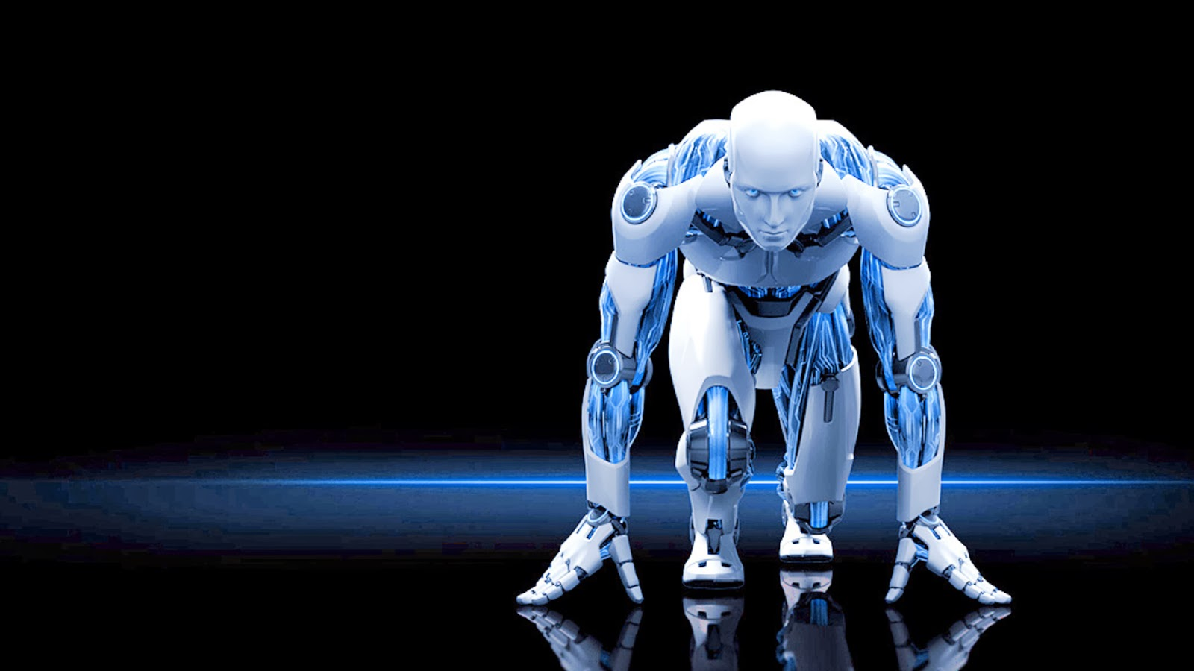
ROBOTICS
Notes:
https://www.analyticsinsight.net/wp-content/uploads/2018/01/Robotics.jpg

Slide 43
VIRTUAL
REALITY
& AUGMENTED
REALITY

Slide 44
Explore the new technology and turn our class in new technology.

Slide 45
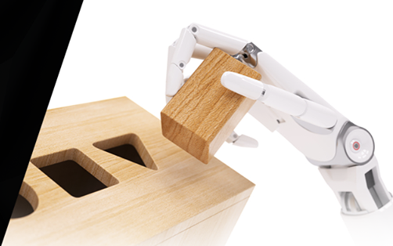
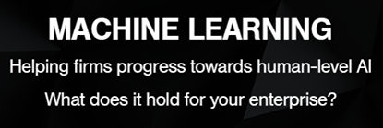

Slide 46
We need to see our TEACHERS and STUDENTS are doing RESEARCH on this sorts of TOPICS and when any of STUDENTS come forward voluntarily to do this sorts of research we will evaluate them and give them MARKS and FUNDS on the basis of their Topics and Enthusiasm

Slide 47
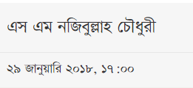

Slide 48
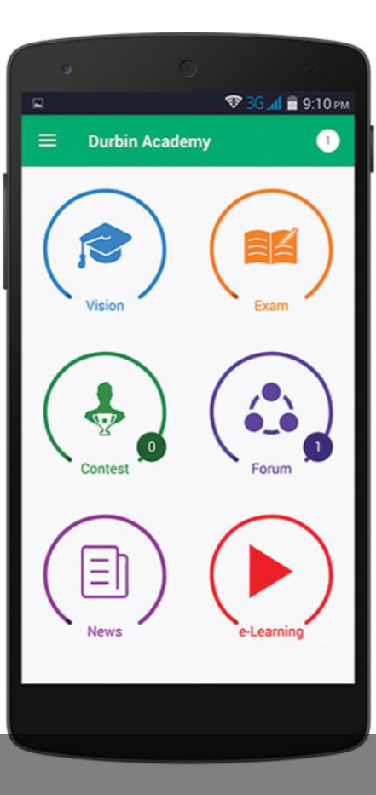

Slide 49
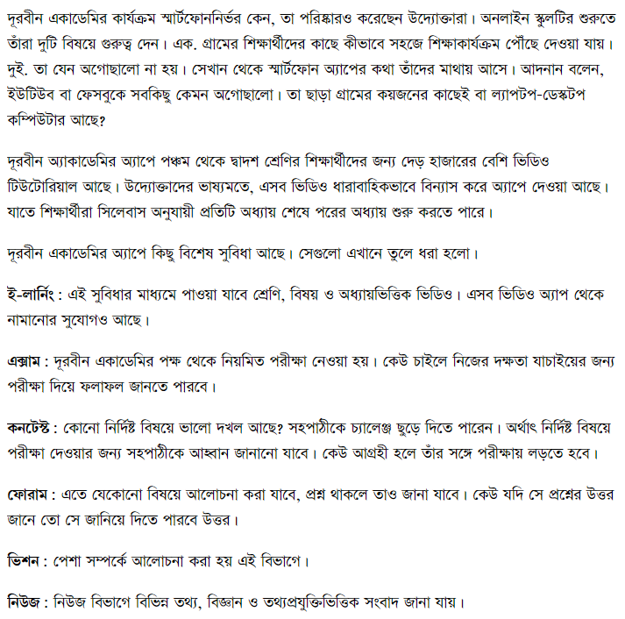
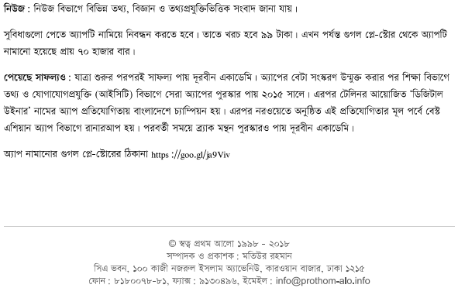

Slide 50
QUESTION AND ANSWER

Slide 51
TAKE AWAY!

Slide 52
TAKE AWAY!

Slide 53
THANK YOU!

